Slide 1
A21-A10
Bonded at 375C, 40N 15 mins
Failed at 2N

Slide 2
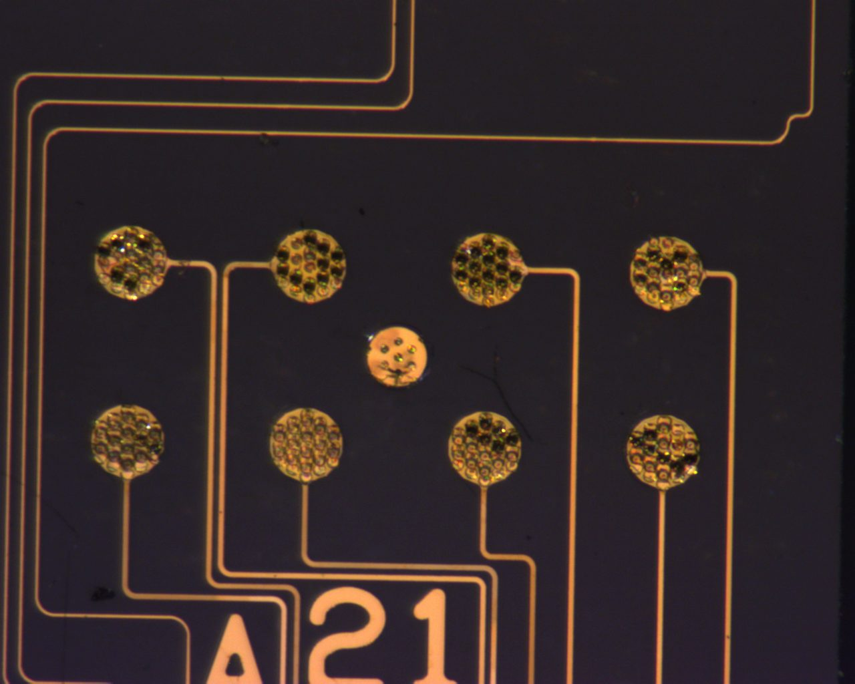
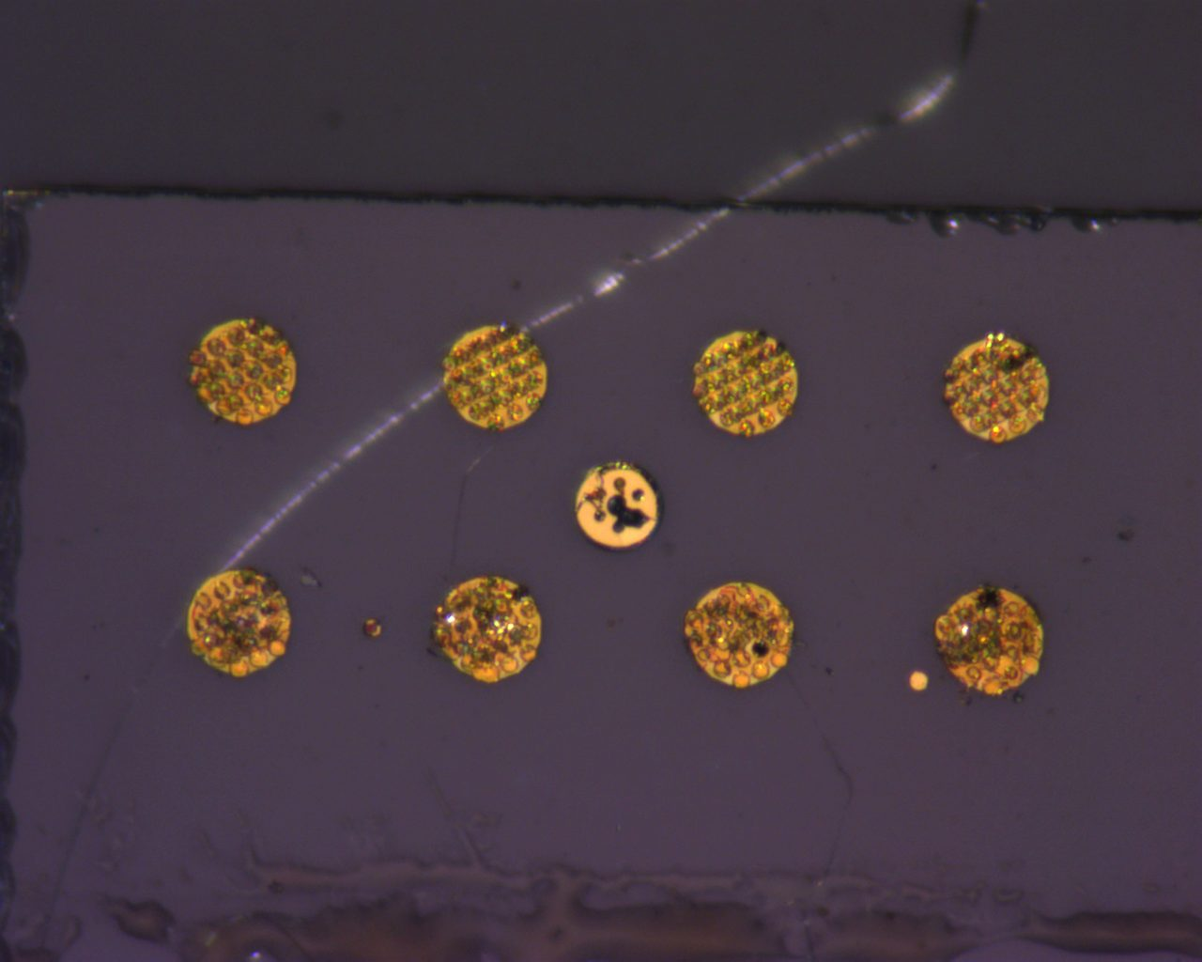
A21 (Front)
Post Pull Test

Slide 3
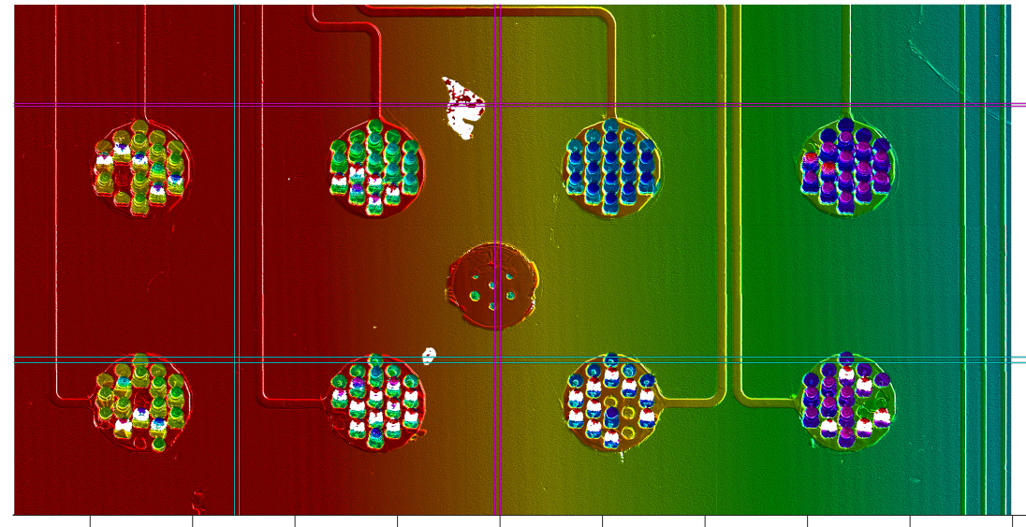
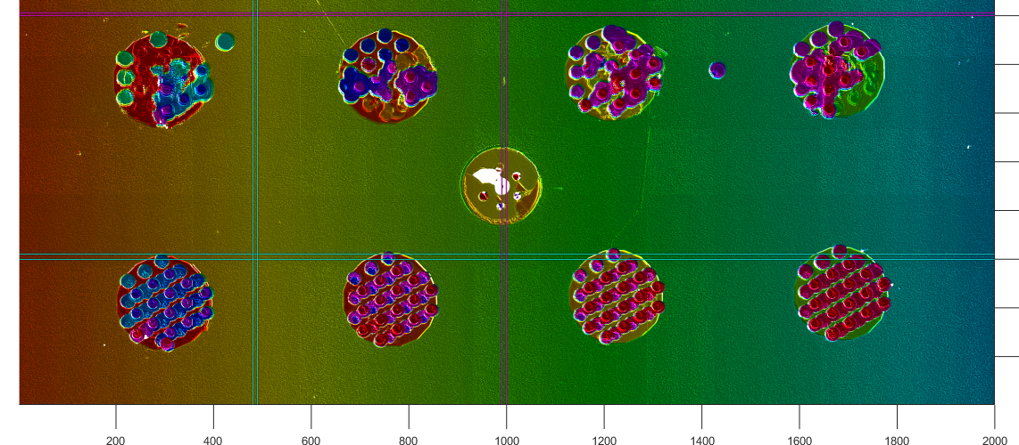
A21

Slide 4
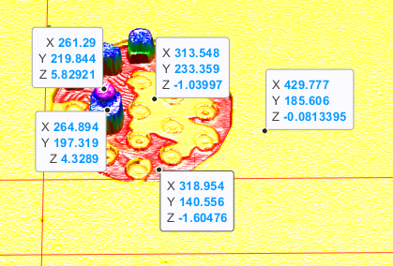
A10 (Front)
Post Pull Test

Slide 5
Summary
Good bonding occurs on all pads
Quite Clearly failure is occurring at titanium-gold layer, and removing portions of PECVD with it
On Pad 9, gold-gold interface is the strongest, while failure occurs at the titanium-gold layer.
Uniform bonding seen across all pads – very similar modes of failure.

